Slide 1


Slide 2
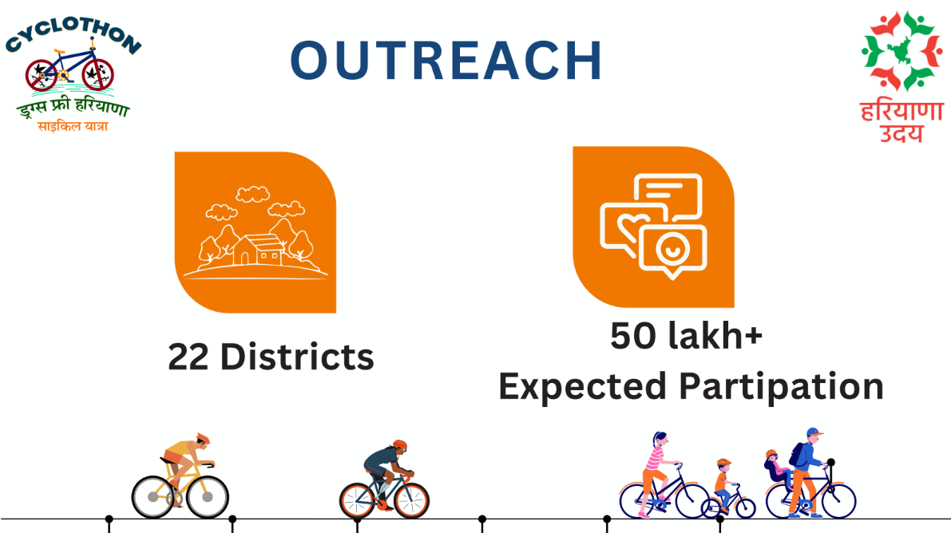

Slide 3
Tentative Road Map of Upcoming Cyclothon 2.0 commencing from 05.04.2025 to 27.04.2025
S# | Date | From | To | Via | Distance (approx.)
1 | 5-Apr-2025 | Hisar | Bhiwani | via Ladwa, Sultanpur, Umra, Ratera, Dhani Kirwar, Tosham, Sagban, Bapora | 62
2 | 6-Apr-2025 | Bhiwani | Charkhi Dadri | Lohani, Jui Khurd, Badhra, Atela Khurd | 76
3 | 7-Apr-2025 | Charkhi Dadri | Narnaul | Mauri, Makrana, Chirya, Baghot, Sehlang, Malra, Majra Kalan, Majra Khurd, Mahendergarh, Nangal Sirohi, Hudlana | 69
4 | 8-Apr-2025 | Narnaul | Rewari | Nuniwal, Bachhod, Khor, Salimpur, Chanedpura, Kathuwass, Bhalkhimajara, Nanda, Mamria | 58
5 | 9-Apr-2025 | Rewari | Palwal | Haska, Jonawas, Dharuhera, Kapriwas, Sidhrawali, Danokri, Jaurasi, Tauru, Rupaheri, Rewasan, Naurangabad, Mandkola, Manderi, Lalwa | 91
6 | 10-Apr-2025 | Palwal | Faridabad | Alipur, Pirthla, Ballabgarh, Tigaon | 47
7 | 11-Apr-2025 | Faridabad | Gurugram | Pali, Dhouj, Lakhuwas, Sohna, Dhunela | 63
8 | 12-Apr-2025 | Gurugram | Jhajjar | Chandu, Kaliyawas, Badsa, Lagarpur, Badli | 48
9 | 13-Apr-2025 | Jhajjar | Rohtak | Chhara, Baproda, Sampla, Ismilla, Kherisaddh, Garhi Bohar | 46
10 | 14-Apr-2025 | Rohtak | Sonepat | Bohar, Bhaloat, Kansala, Sisana, Kharkhoda, Jharont, Rohat | 49

Slide 4
S# | Date | From | To | Via | Distance (approx.)
11 | 15-Apr-2025 | Sonepat | Panipat | Murthal, Gannaur, Patti Kalyana, Samalkha, Siwah | 51
12 | 16-Apr-2025 | Panipat | Karnal | Munak, Gagsina, Sataundi, Barota | 48
13 | 17-Apr-2025 | Karnal | Yamuna Nagar | Indri, Ladwa, Radaur, Damla | 65
14 | 18-Apr-2025 | Yamuna Nagar | Naraingarh | Jagadhari, Bherthal, Bilaspur, Marwa Kalan, Sadhaura, Tibri, Saidupur, Ambli, Barsu Majra | 54
15 | 19-Apr-2025 | Naraingarh | Panchkula | Laha, Kohra-Bhura, Pyarewala, Gharhi-Kotaha, Raipurrani, Manak Tabra, Ambrala, Shamtu, Rattewali, Kanauli, Kot, Jaswantgarh, Billa | 46
16 | 20-Apr-2025 | Panchkula | Ambala | Bawrwala, Shahjadpur, Pathreri, Karasan, Pilkhani | 72
17 | 21-Apr-2025 | Ambala | Kurukshetra | Mohra, Khanpur Jattan, Charuni Jattan, Khanpur Kolian | 43
18 | 22-Apr-2025 | Kurukshetra | Kaithal | kamoda, Pindarsi, Dhand, Pharal, Pundri, Mundri | 58
19 | 23-Apr-2025 | Kaithal | Jind | Kalayat, Narwana, Uchana | 79
20 | 24-Apr-2025 | Jind | Barwala | Narnaund | 55
21 | 25-Apr-2025 | Barwala | Fatehabad | Daulatpur, Bhuna, Jandli Khurd, Jhalanina | 55
22 | 26-Apr-2025 | Fatehabad | Sirsa | Daryapur, Moriwala | 40
24 | 27-Apr-2025 | Sirsa | Dabwali | Panjuana, Sahuwala, Panniwala Mota, Odhan, Chormar Khera, Mithri | 56

Slide 5
Information Required from Districts
Sr No. | Name of District | Name of Dignitary for Welcome of Cycle Rally | Name of Dignitary for flag-off the Cycle Rally | Nodal officer from Administration with Mobile No. | Nodal officer from Police with Mobile No.
1
2
3
4
5

Slide 6

THANKS.!

